Slide 1
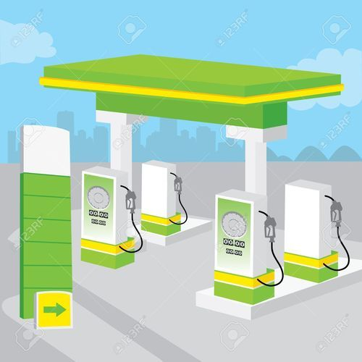

School of Computing Science & Engineering

Slide 2


Group-83

Slide 3
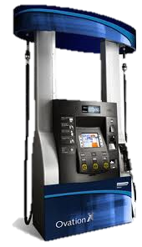



ABHISHEK THAPLIYAL-20BCE10231
PRESENTERS
GAURAV SAHU-20BCE11043
ANIKET KHARE-20BCE10363
SNEHA AGARWAL-20BCE10635
UTKARSH KUMAR-20BCE10622

Slide 4

Advantage of Proposed System.
Introduction/
Objectives.
Architectural Diagram/Flow Diagram.
Demo Code with Screenshots
Problem Statement/Novelty
Module Split-up/Gantt Chart

Slide 5

INTRODUCTION
The idea of our Petrol pump management system is mainly to manage daily records of petrol pump.
Using this system the admin will be able to check the employee attendance, quantity of petrol and diesel sold in any day, week or month.
We can also set the rating for petrol and diesel for that day as we know that it varies from day to day.
User can generate reports easily form this petrol pump management system.

Slide 6





OBJECTIVES
To make a software which is easy to use.
To improve the present Petrol Pump Management System.
To check the quantity of fuel.
To minimize manual calculation.
Getting information related to sales on daily basis.

Slide 7


PROBLEM STATEMENT
Most of details are maintained manually. Due to this the data retrieved is time consuming. Due to human calculation errors occur.
Even when the data is maintained on spreadsheet inconsistency occurs as an order might be missed or wrongly entered or twice.
Data are stride an excel sheet which takes lot of time and data may be corrupted.
As storage and exchange of data is achieved only by use of excel sheets which lack validation
capabilities, there is always risk of invalid, inaccurate or incomplete data being fed in computer.
Difficulty in managing multiple forms.
Lack of security.

Slide 8





ADVANTAGE OF OUR PROPOSED SYSTEM
A database application can be stored in computer effectively.
No cheating in the numbers can be done.
Whenever rates will fluctuate on time changes would be made.
Time management.
No need to check manually the quantity left
With this system, less man force will be required.

Slide 9
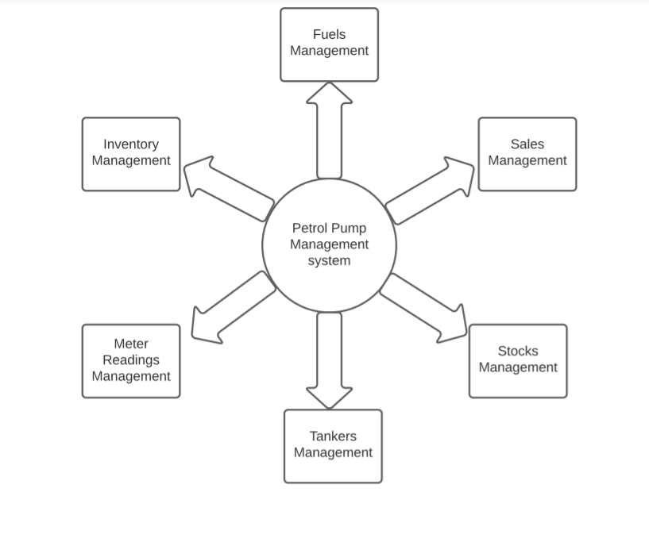
ARCHITECTURE DIAGRAM

Slide 10
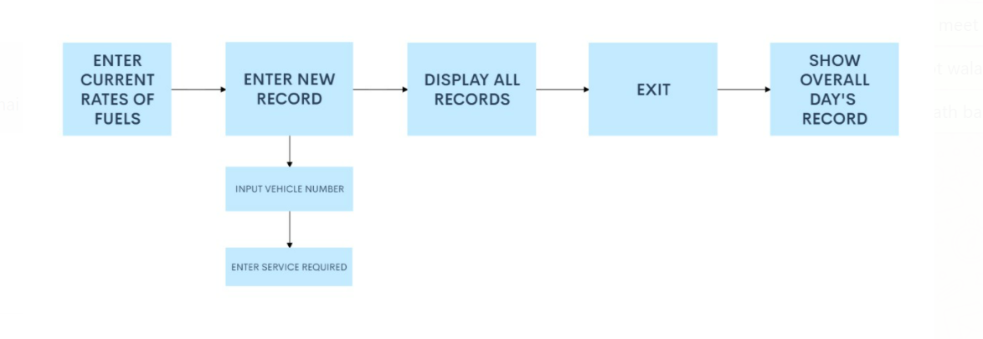
FLOW DIAGRAM

Slide 11




NOVELTY OF THE PROJECT
All the information about sale, purchase, stock will be maintain properly in this system.
All manual calculation of sale or all the money management will be performed by the computer automatically.
This system will provide timely report information.
It will produce report for sale, bill and stock information.
The computer can hold amount of data in its storage device

Slide 12
CODE STRUCTURE/DEMO CODE
Firstly we include all the necessary libraries that we are going to required in project which like:-
<ctype.h>, <string.h>, <stdio.h>, <dos.h>, <iomanip.h>, <iostream.h>, <fstream.h>, <process.h>, <conio.h>, etc.
After we will construct a parent class namely Pump() in which we will define some public, private and protected variables, data structures(arrays,vectors,etc)and functions that we are going to use in program.
Some important functions that we are going to use:-
1) void end() : It will show the ending page of the program when we choose to exit from program.
2) void sale(): It will show the page which will show the total sales of that day when we exit from the program
before the ending page.
3) void start(): It will show the starting page of our program after we run and compile the code. It is the
template of program introduction.
Cont…

Slide 13
4) int service(): It will show the options that customers wanted to opt in servicing of car like Washing ,
polishing, etc.
5) void entry(): It will show the main menu of program in which we can select what we wanted to do for
our like petrol, diesel, tyre, services, etc.
6) int tyers(): It will show options that what we wanted to do in tyre section of main menu like buying
tyres and tubes of vehicle.
7) void show(): It will show all the records of all the vehicles visited from the starting date of pump.
9) void find(): It is used to find the record of a particular vehicle by the vehicle number.
10) void password(): In the start of program it will ask for password of the program.
After the construction of these function finally we will construct the int main() function of code by combining the these function with appropriate direction of way and hence completes our code.

Slide 14

IMPLEMENTATION SCREENSHOTS

Slide 15
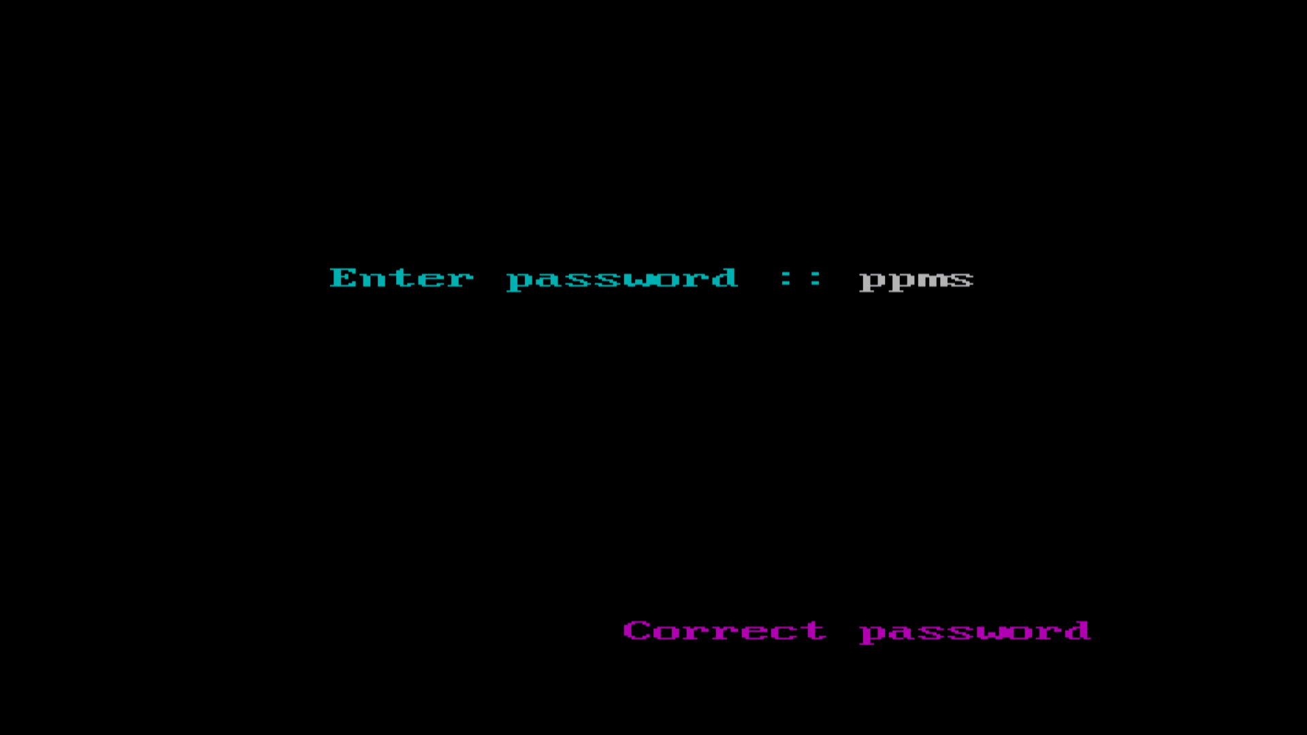

Slide 16
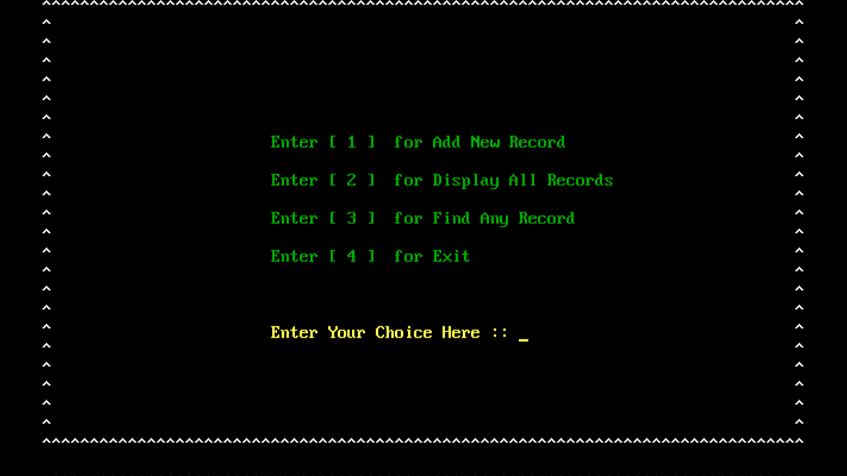

Slide 17
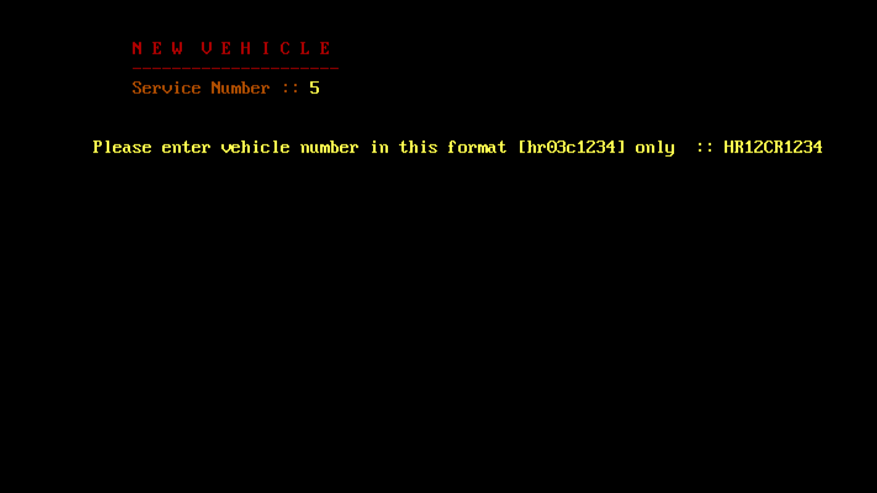

Slide 18
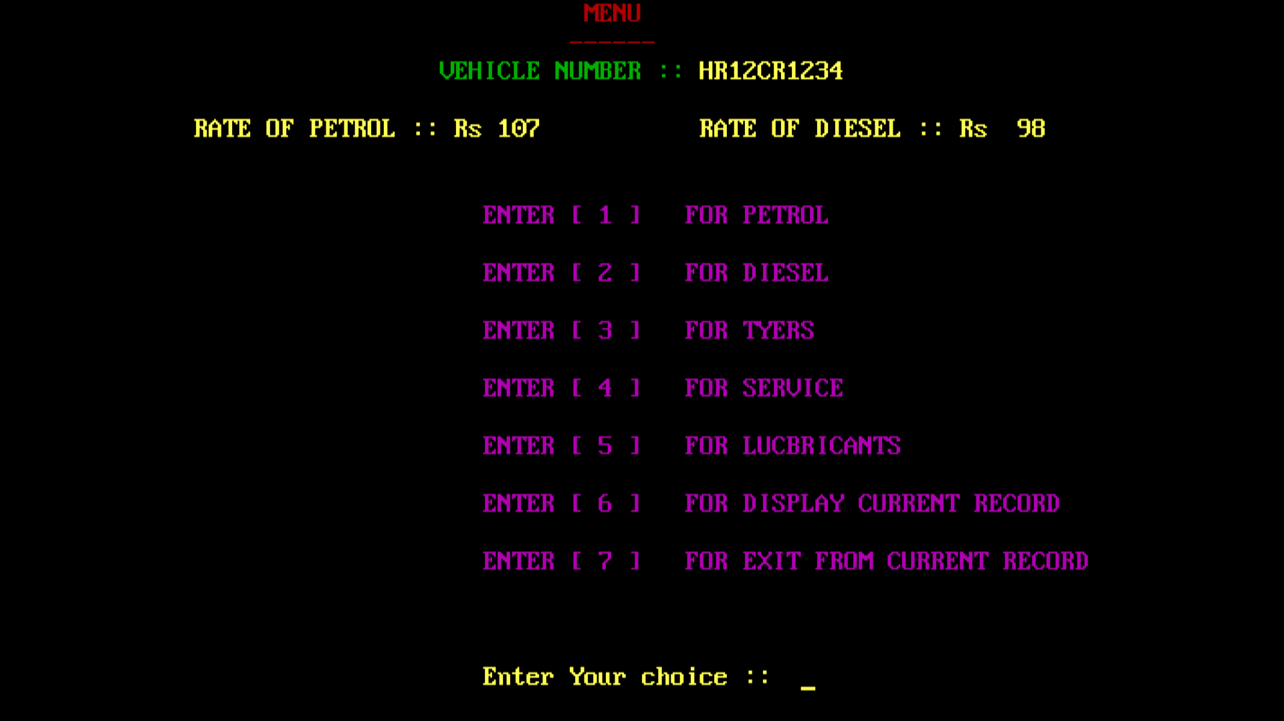

Slide 19
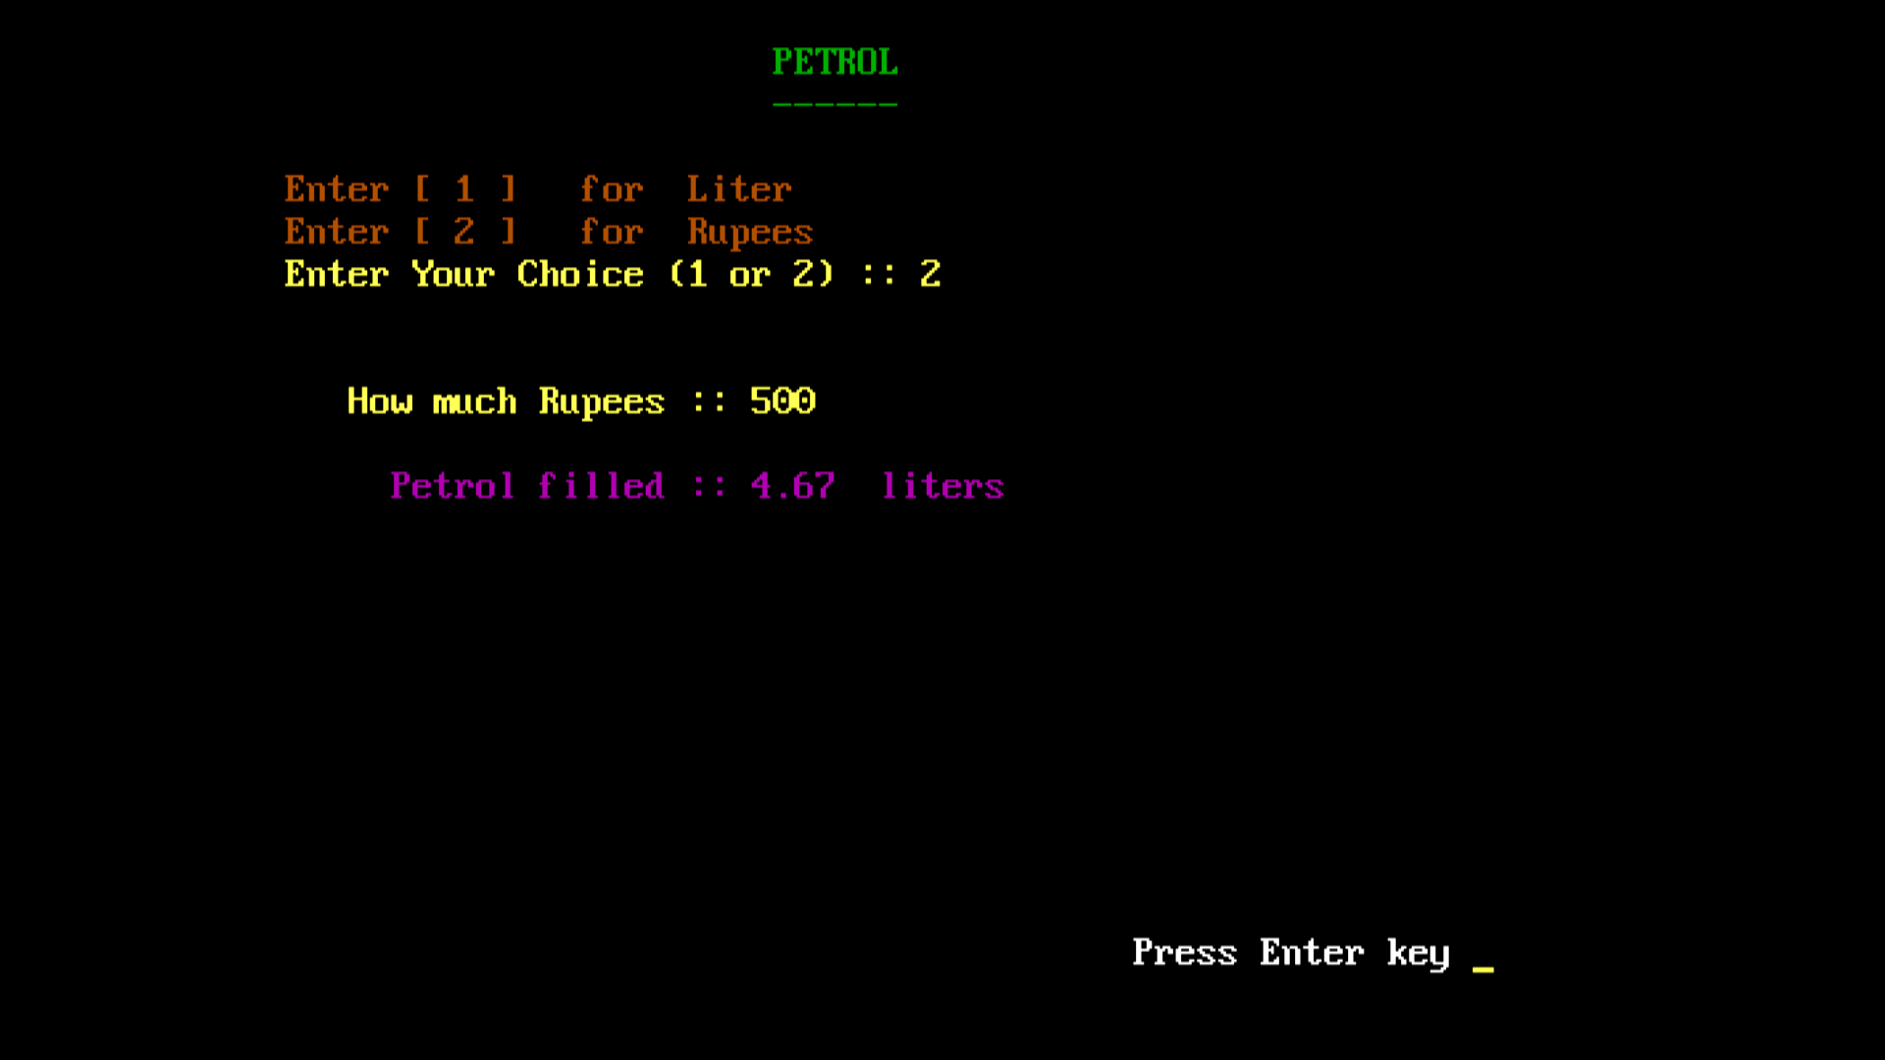

Slide 20
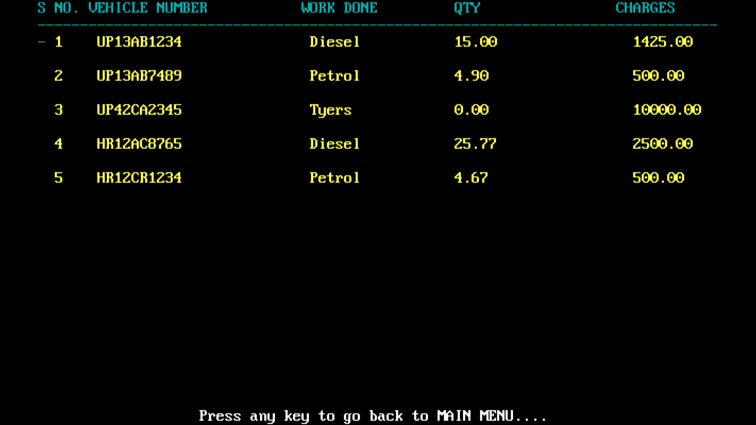

Slide 21
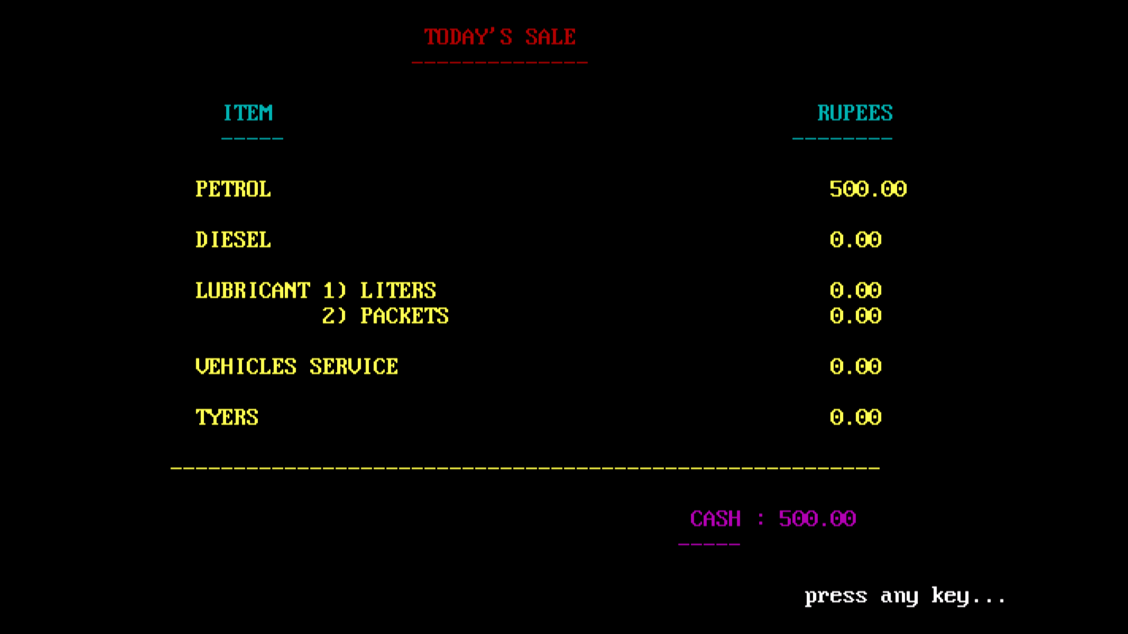

Slide 22
Module Split-up
S.NO | Particular | Duration | Explanation
1. | Module-1 (Introduction) | 4 days | Introduction to Petrol Pump Management System, Its Objectives, Its Real Time Usage
2. | Module-2 | 4 days | Existing Petrol Pump Management System & Its Limitations
3. | Module-3 | 4 days | Proposed Petrol Pump Management System, Novelty, Its Advantage
4. | Module-4 | 6 days | Gantt Chart, Flow Diagram, Demo Code/Code Structure
5. | Module-5 | 7 days | Implementation Screenshots and Code

Slide 23
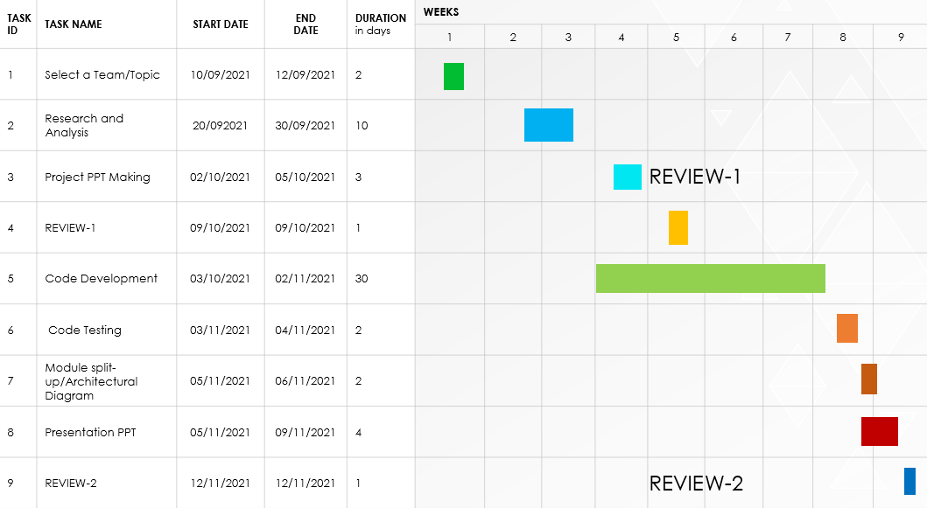
GANTT CHART

Slide 24

THANK YOU

